Slide 1

Project Title – Seasonal Agriculture Performance Analysis
Name : Anirban Bishnu
Collage Name : University Institute of Technology
AICTE STU ID : STU6a6788dc7129f1785170140

Slide 2

PROBLEM STATEMENT
Agricultural performance varies significantly across seasons due to changes in environmental conditions, farming practices, resource availability, and market conditions. However, raw agricultural data does not clearly explain how these factors influence crop yield, production, resource efficiency, and profitability across different seasons.
The problem is to analyze the agricultural dataset and identify meaningful seasonal patterns, trends, relationships, and variations in agricultural performance, so that differences between seasons can be understood and used to support better agricultural planning and decision-making.

Slide 3

WHO ARE THE END USERS?
Farmers – to understand seasonal crop performance, yield, resource usage, and profitability.
Agricultural Planners & Advisors – to support seasonal crop planning and resource allocation.
Government & Agriculture Departments – to support evidence-based agricultural policies and programs.
Agribusiness & Input Suppliers – to understand seasonal demand for irrigation, fertilizers, pesticides, and other inputs.
Researchers & Data Analysts – to study relationships between environmental conditions, farming practices, and agricultural outcomes.
In short: The project helps stakeholders make data-driven decisions for better seasonal agricultural planning, resource efficiency, and profitability.

Slide 4
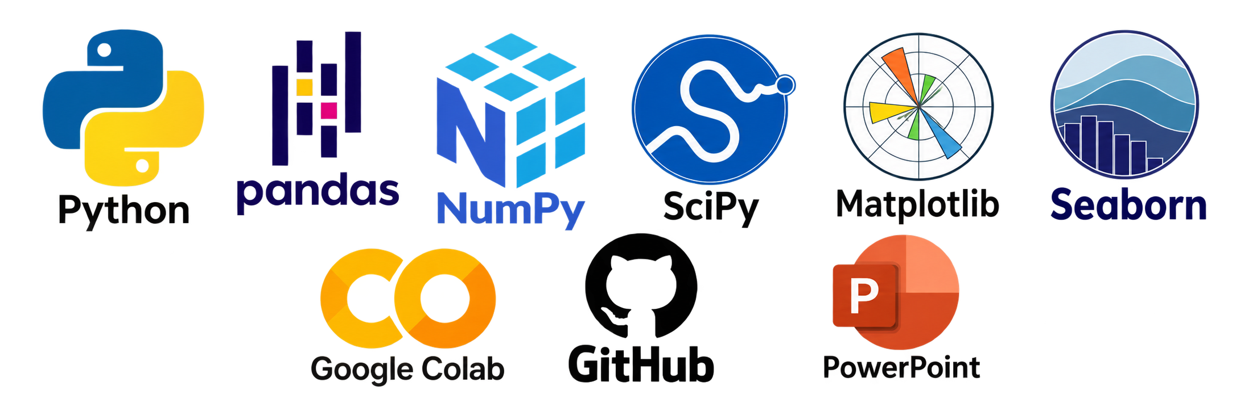

Technology Used
Programming & Analysis
Python
Pandas
NumPy
SciPy
Data Visualization
Matplotlib
Seaborn
Development Environment
Google Colab – for running and documenting the complete Jupyter Notebook analysis.
Documentation & Version Control
GitHub – for storing and sharing the project notebook, dataset, code, and documentation.
Presentation
Microsoft PowerPoint
  Analytical workflow: Inspect → Clean → Compare → Visualize → Test → Interpret

Slide 5
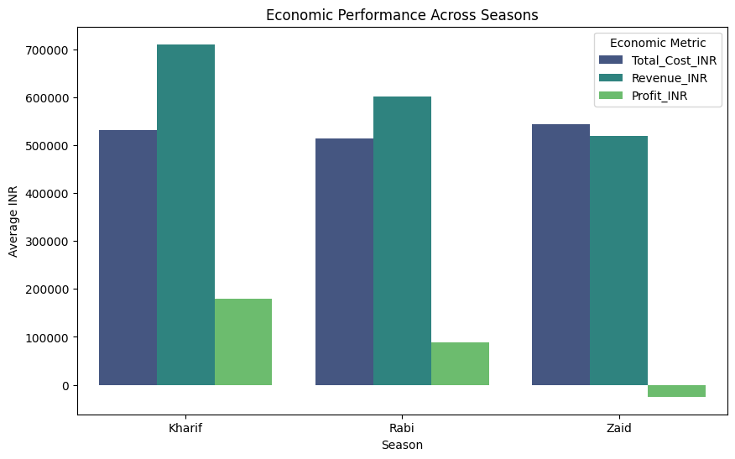
RESULTS
Key Insight : Kharif is the most profitable season, while Zaid operates at a loss due to costs exceeding revenue.

Slide 6
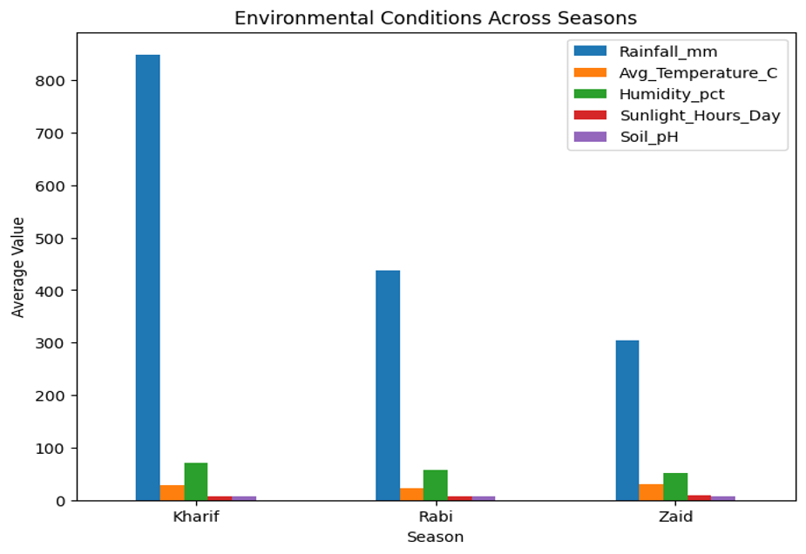
RESULTS
Key Insight: Kharif has the highest rainfall and humidity, while Zaid is the hottest and driest season, highlighting clear seasonal differences in environmental conditions.

Slide 7
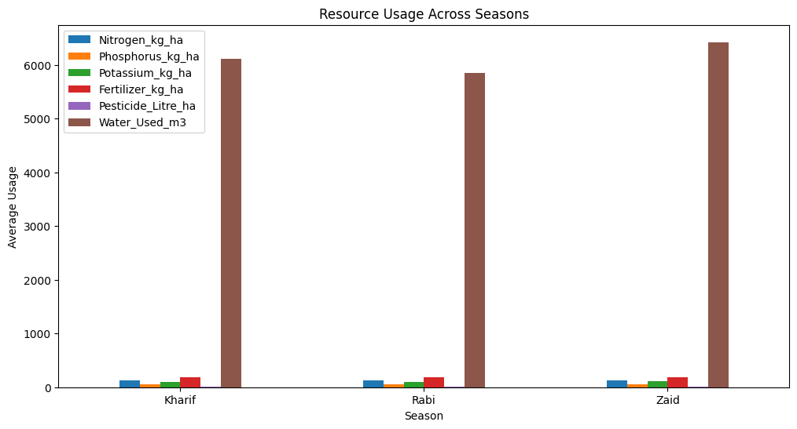
RESULTS
Key Insight: Kharif uses the highest water resources, while Zaid consumes the most water overall, highlighting the need for improved seasonal water management.

Slide 8
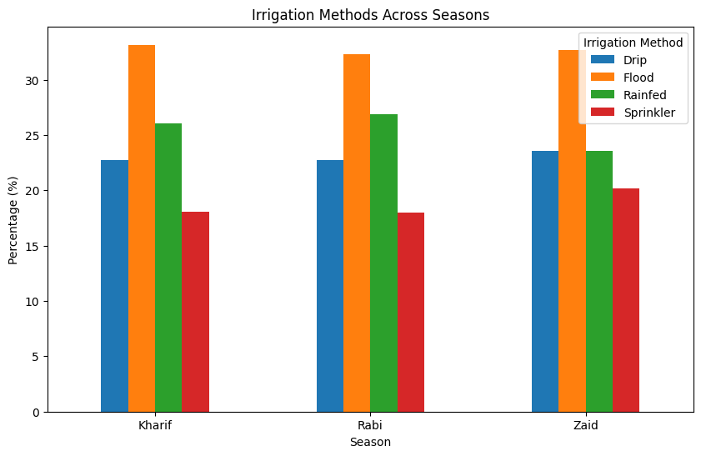
RESULTS
Key Insight: Flood irrigation is the most widely used method across all seasons, while Drip irrigation has a smaller but consistent share.

Slide 9
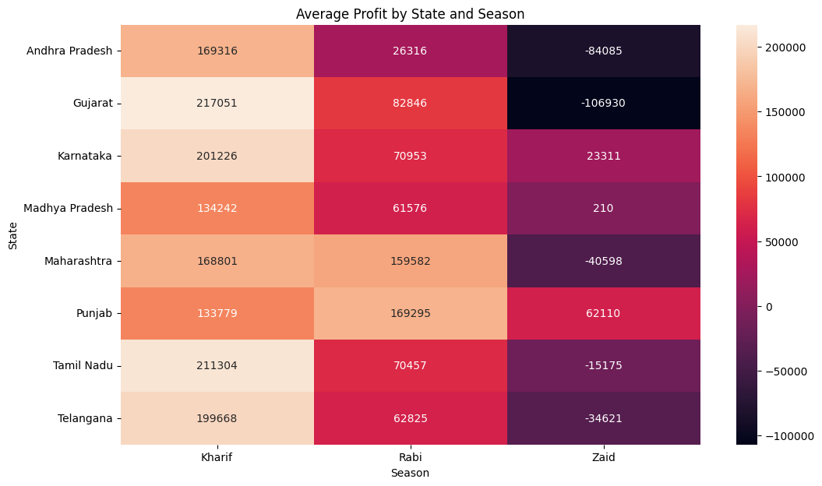
RESULTS
Key Insight: Kharif is the most profitable season across most states, while Zaid records negative profits in several states, showing strong regional and seasonal variation in profitability.

Slide 10
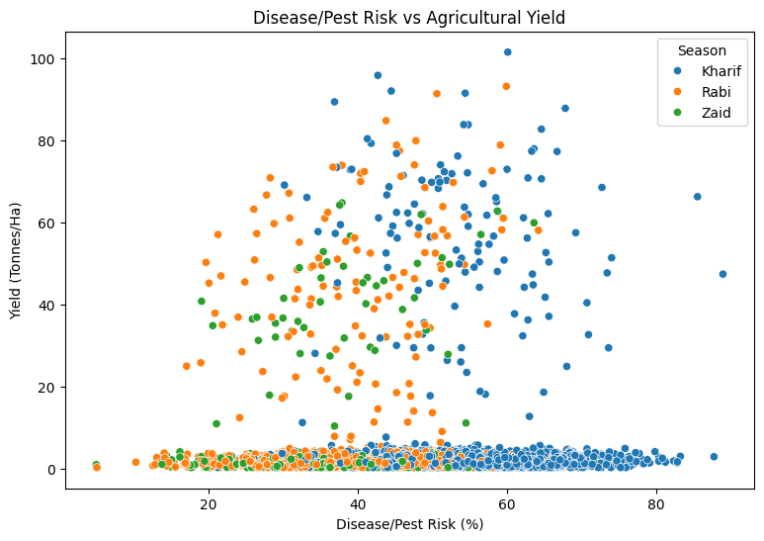
RESULTS
Key Insight: Disease/Pest risk shows variation across seasons, but the relationship with agricultural yield is not consistently strong, indicating that other factors also influence yield.

Slide 11
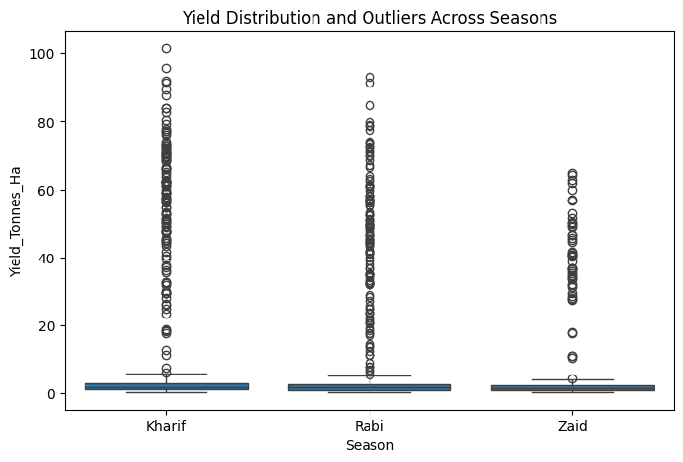
RESULTS
Key Insight: Kharif shows the widest yield variation and highest outliers, while Zaid has a lower overall yield range, indicating seasonal differences in yield distribution.

Slide 12
Future scope
Multi-Year Analysis: Use data from multiple years to validate seasonal trends and improve reliability.
Predictive Analytics: Develop machine-learning models to forecast crop yield, revenue and profitability.
Weather Integration: Incorporate real-time weather and climate data for better seasonal prediction.
Crop & Region Optimization: Identify the most suitable crop–season–region combinations for higher returns.
Smart Resource Management: Optimize water, fertilizer and irrigation usage to improve productivity and sustainability.

Slide 13
GitHub Link
https://github.com/Anirban-Bishnu/Seasonal-Agriculture-Performance-Analysis/tree/main
Google Colab Link :
https://colab.research.google.com/drive/1M4RQRjmjWe2si6QuJ2pzNEyjS4IO3rNT#scrollTo=2nbKqI9rdDVd

Slide 14

VOIS Course Completion Certificate –
Course name: Data Visualization

Slide 15
Thank you

